Slide 1
Sketched Learning from Random Features Moments
Nicolas Keriven
Ecole Normale Supérieure (Paris)
CFM-ENS chair in Data Science
(thesis with Rémi Gribonval at Inria Rennes)
Telecom-Paristech, Apr. 16th 2018

Slide 2
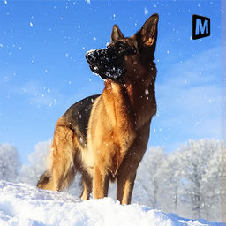
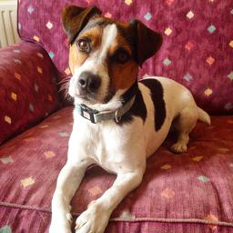
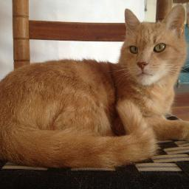
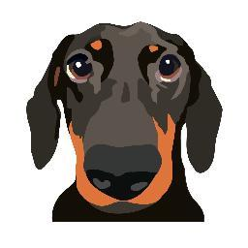
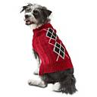
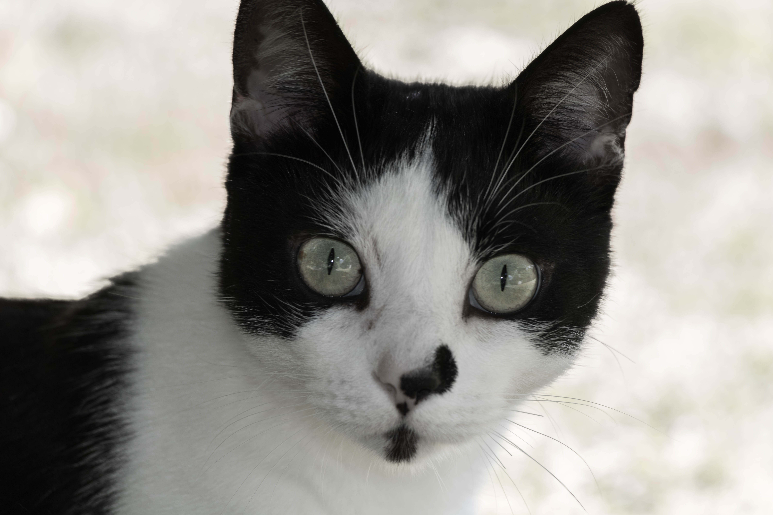
Context: machine learning
Database
Task
Learning
Clustering
Classification
etc…
= cat
1/24

Slide 3
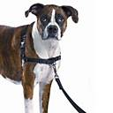
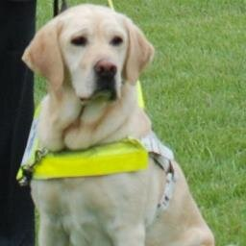
Context: machine learning
Large database
Task
Learning
Clustering
Classification
etc…
Slow, costly
= cat
Distributed database
2: Learning
Idea!
1: Compression
Small intermediate
representation
Data Stream
Desired properties
Fast to compute (distributed, streaming, GPU…)
Preserve desired information
Preserve data privacy
…
…
2/24

Slide 4
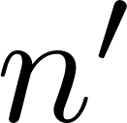
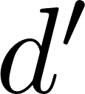
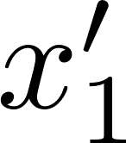
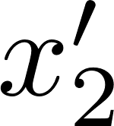
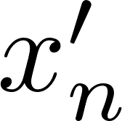
Three compression schemes
Database
Feature
extraction
Compression ?
. . .
Data = Collection of vectors
Subsampling
coresets
See eg
[Feldman 2010]
Uniform sampling (naive)
Adaptive sampling…
Linear sketch
See [Thaper 2002]
[Cormode 2011]
Hash tables, histograms
Sketching for learning ?
. . .
Dimensionality reduction
See eg [Calderbank 2009, Boutsidis 2010]
Random Projection
Feature selection
. . .
Distributed,
streaming
3/24

Slide 5
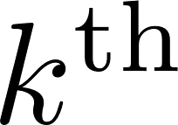
How-to: build a sketch
What is a sketch ?
Questions:
Any linear sketch = empirical moments
What information is preserved by the sketching ?
How to retrieve this information ?
What is a sufficient number of features ?
What is contained in a sketch ?
: mean
: moment
: histogram
Proposed: kernel random features [Rahimi 2007] (random proj. + non-linearity)
Intuition: sketching as a linear embedding
Assumption:
Linear operator:
« Noisy » linear measurement:
Noise small
Dimensionality-reducing, random, linear embedding: Compressive Sensing?
4/24

Slide 6
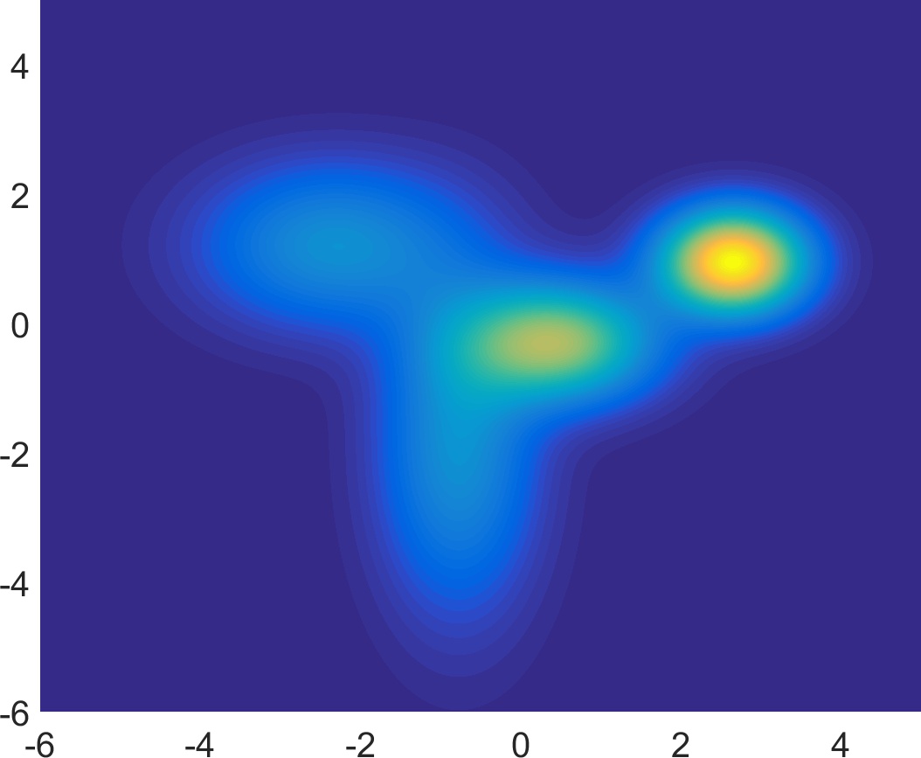
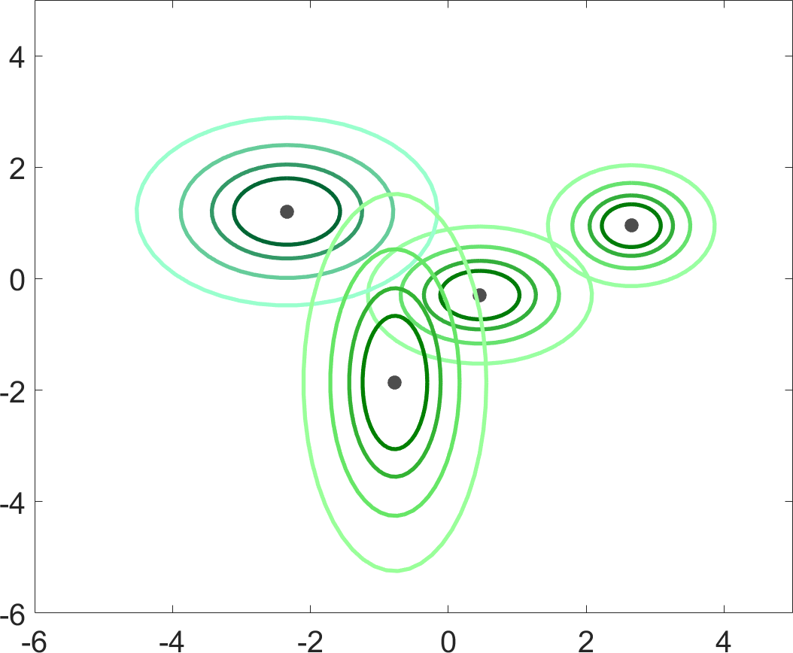
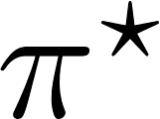
Compressive Sensing: sparsity ?
Compressive Sensing:
Dimensionality reduction, random operator
(Ill-posed) inverse problem: density estimation
Sparsity: « simple » densities (mixture model)
Classical compressive sensing
Random matrix
Sketched learning in this talk
Random features
averaged
5/24

Slide 7
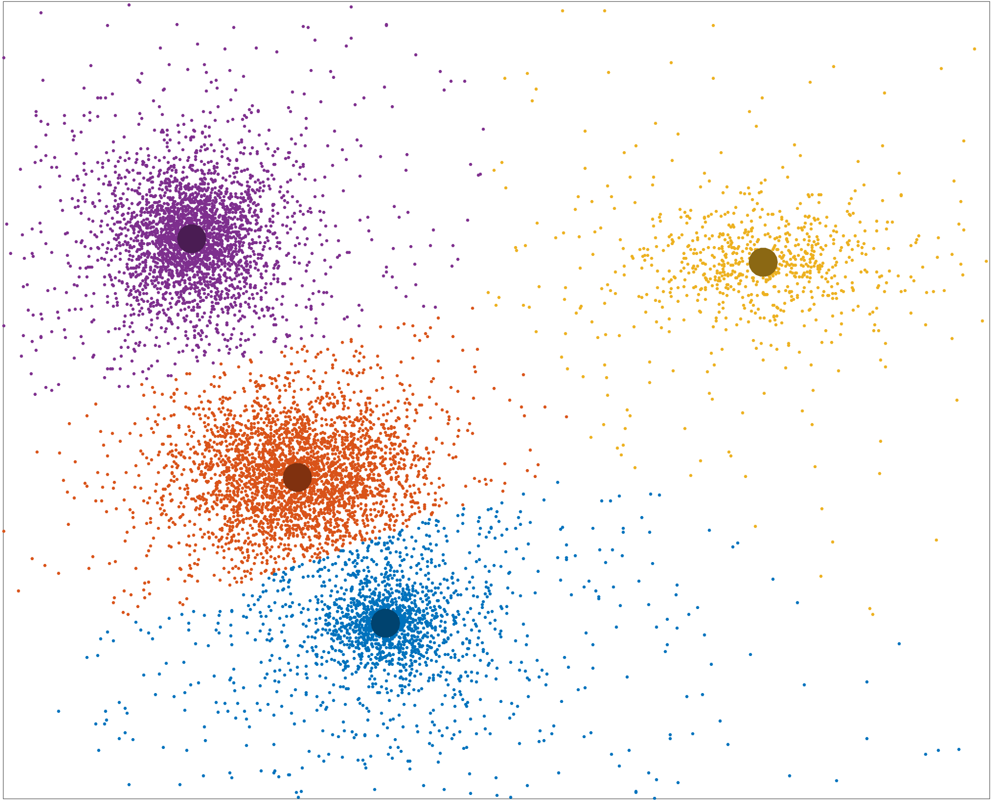
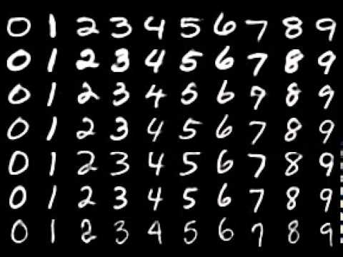
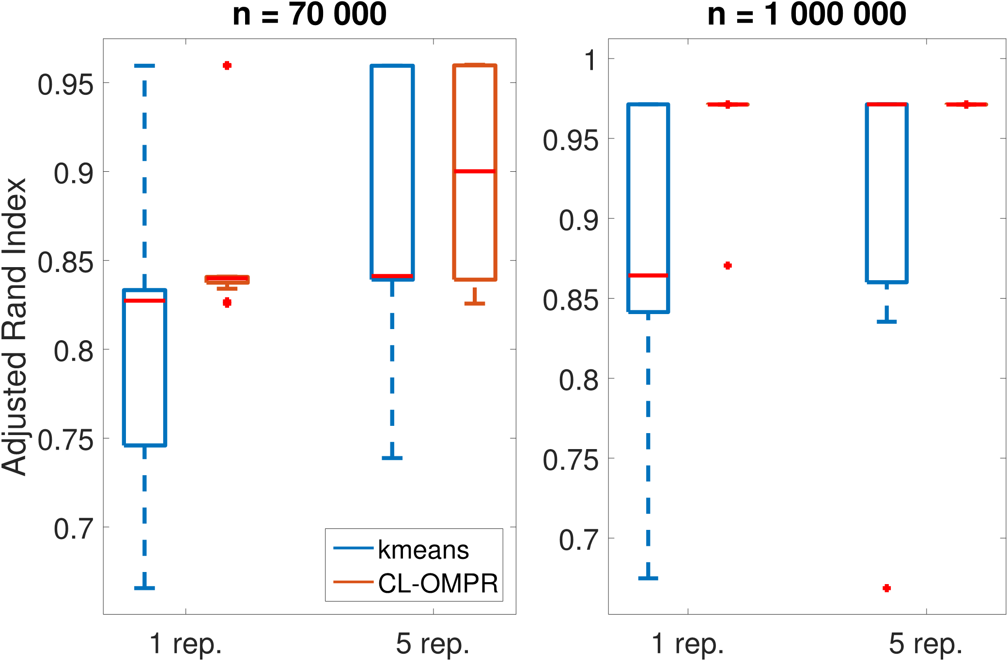
Illustration 1: Compressive k-means
Joint work with N. Tremblay, R. Gribonval, Y. Traonmilin
CL-OMPR: greedy heuristic for sketched mixture model learning [Keriven 2016]
Mixture of Diracs = k-means
Application: Spectral clustering for MNIST classification [Uw 2001]
Classif. Perf.
On this example…
1 order of magnitude faster than k-means (Matlab)
4 orders of magnitude smaller memory footprint
6/24

Slide 8
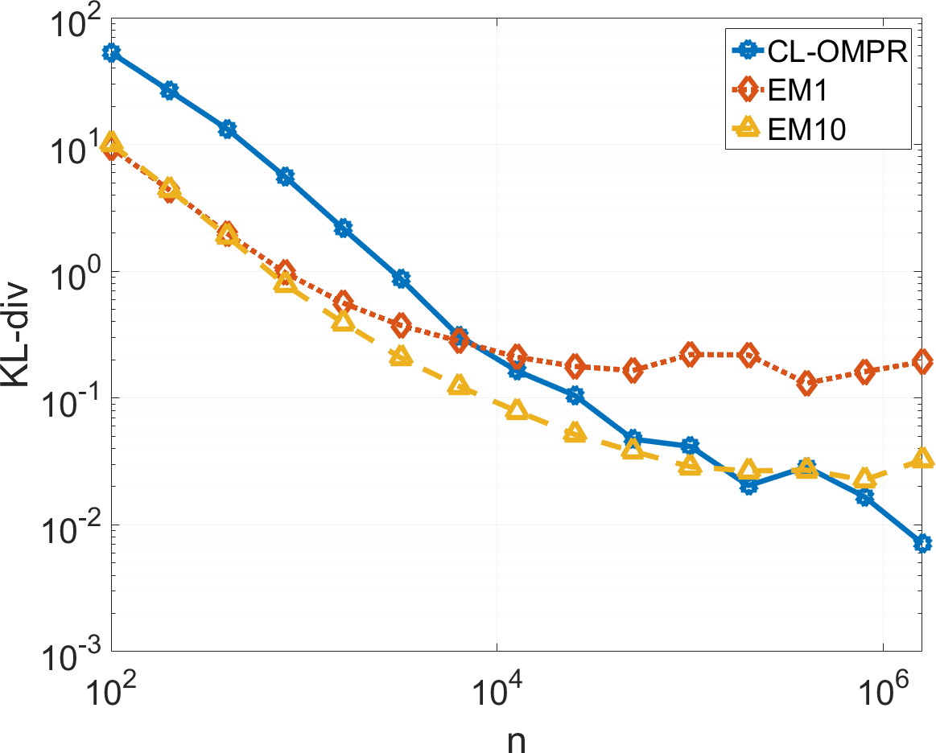
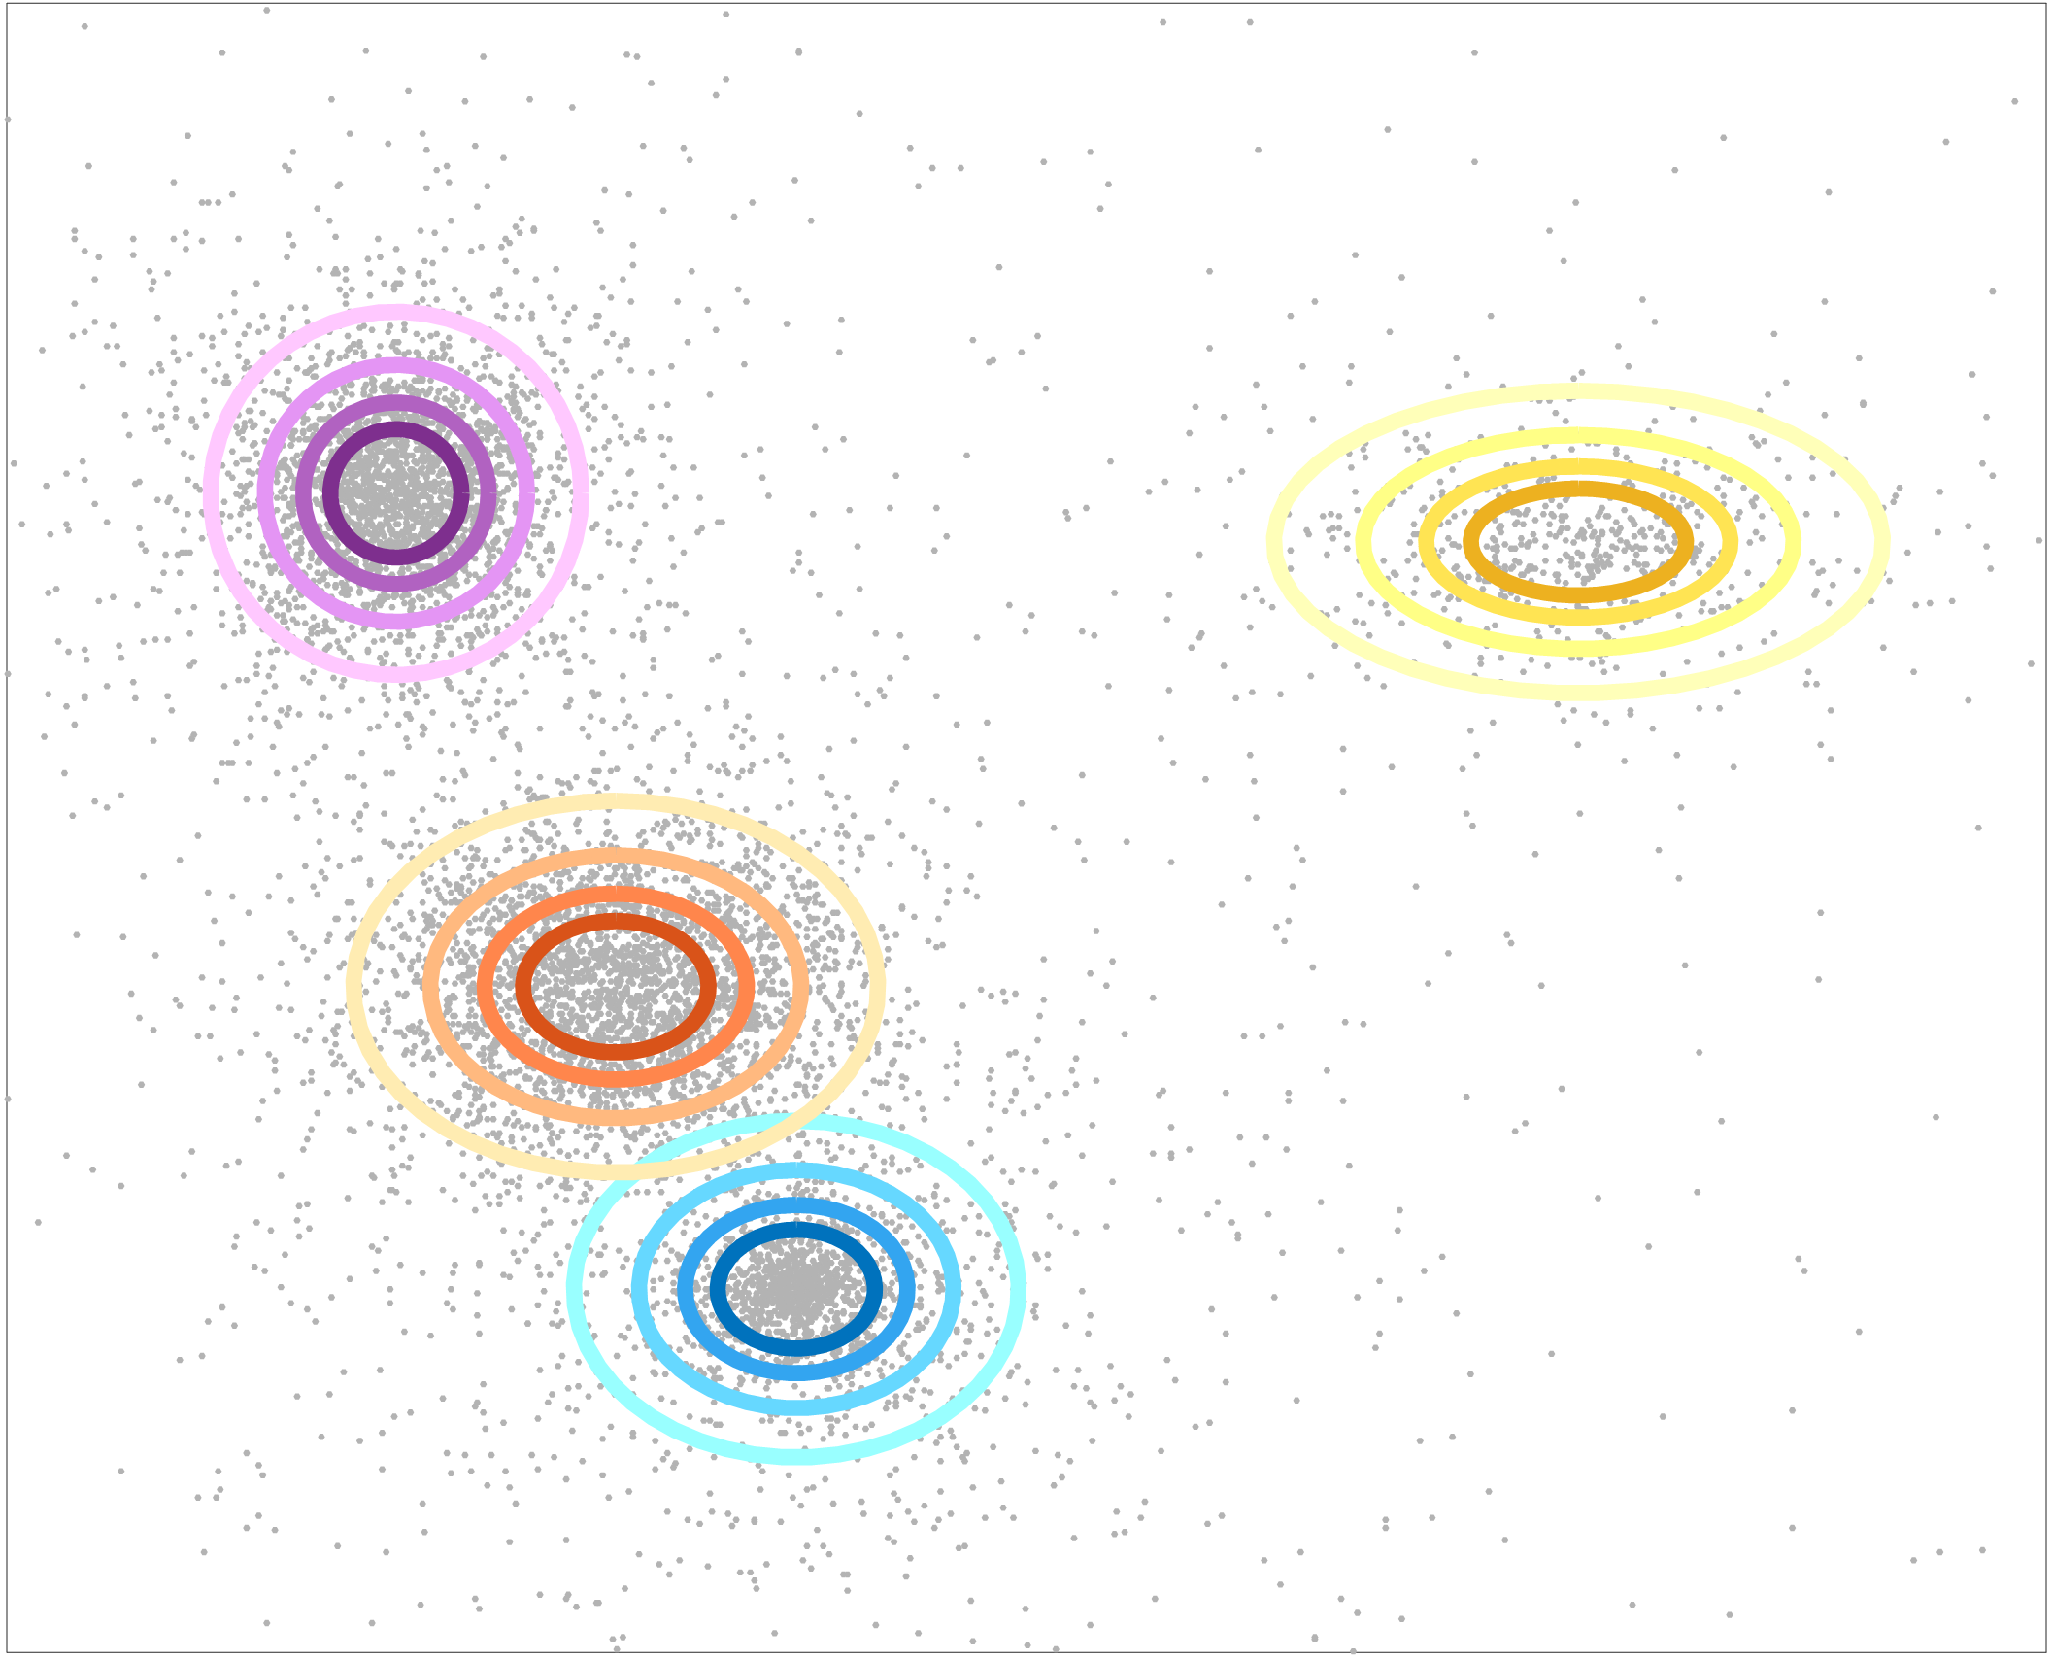
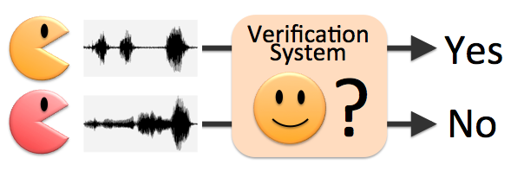
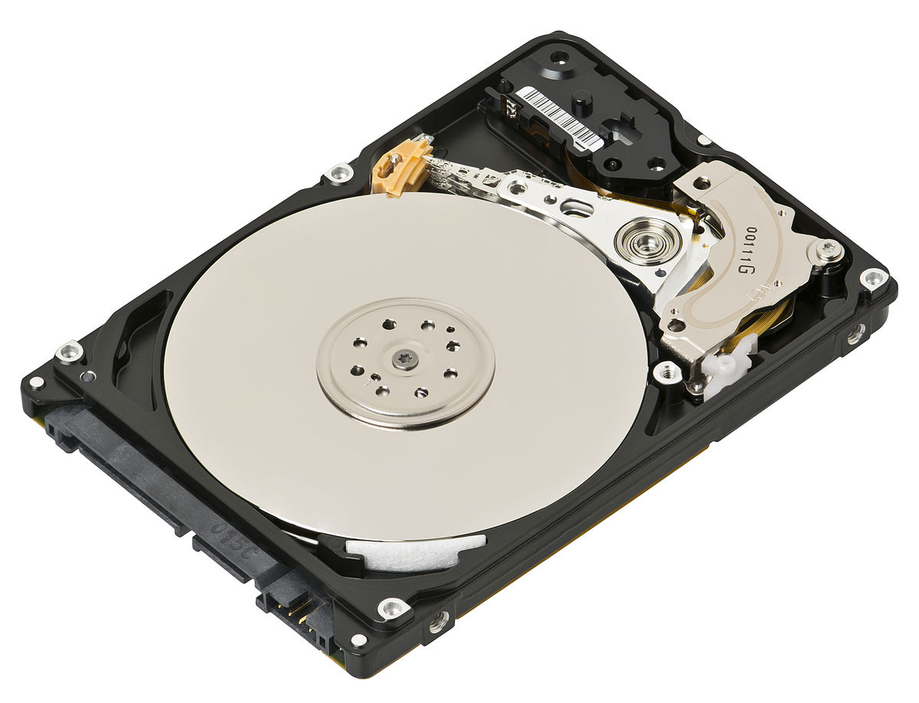
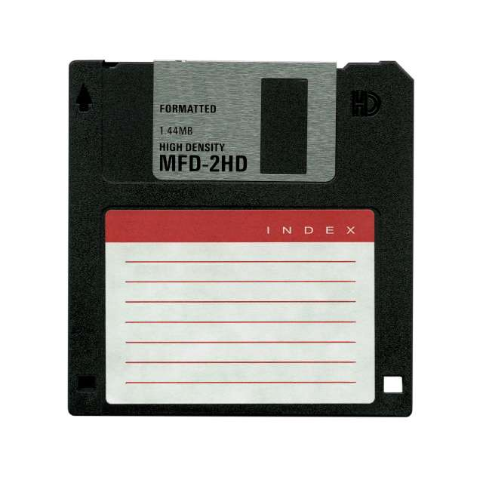
Illustration 2: Sketched GMM
Joint work with A. Bourrier, R. Gribonval, P. Pérez
d = 10, k = 20
GMM
Error
Faster than EM
(VLFeat’s gmm)
Size of database
Application: speaker verification [Reynolds 2000] (d=12, k=64)
EM on 300 000 vectors : 29.53
20kB sketch computed on 50GB database: 28.96
7/24

Slide 9
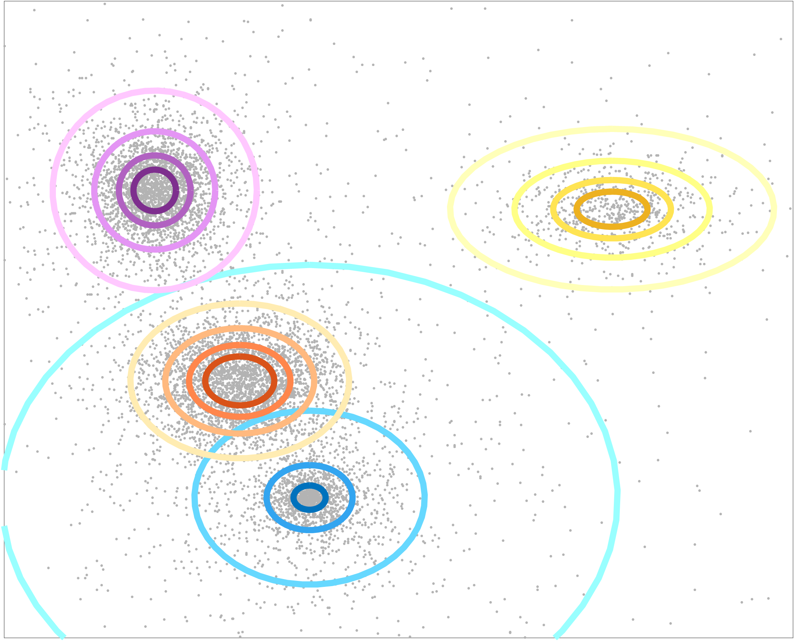
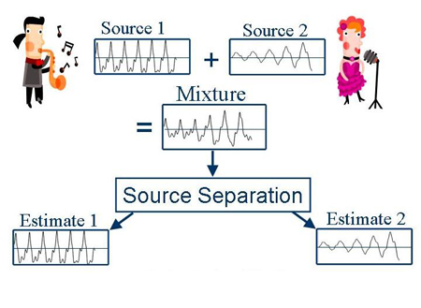
Illustration 3: Audio Source separation
Joint work with A. Deleforge, A. Liutkus.
CL-OMPR more flexible than likelihood-based approaches…
Mixture of stable dist.
Application: audio source separation
Model: hybrid between rank-1 alpha-stable and Gaussian noise…
8/24

Slide 10
In this talk
Q: Theoretical guarantees ?
Inspired by Compressive Sensing:
1: with the Restricted Isometry Property (RIP)
2: with dual certificates
9/24

Slide 11
Outline
Information-preservation guarantees: a RIP analysis
Total variation regularization:
a dual certificate analysis
Conclusion, outlooks

Slide 12
Outline
Information-preservation guarantees: a RIP analysis
Joint work with R. Gribonval, G. Blanchard, Y. Traonmilin
Total variation regularization:
a dual certificate analysis
Conclusion, outlooks

Slide 13
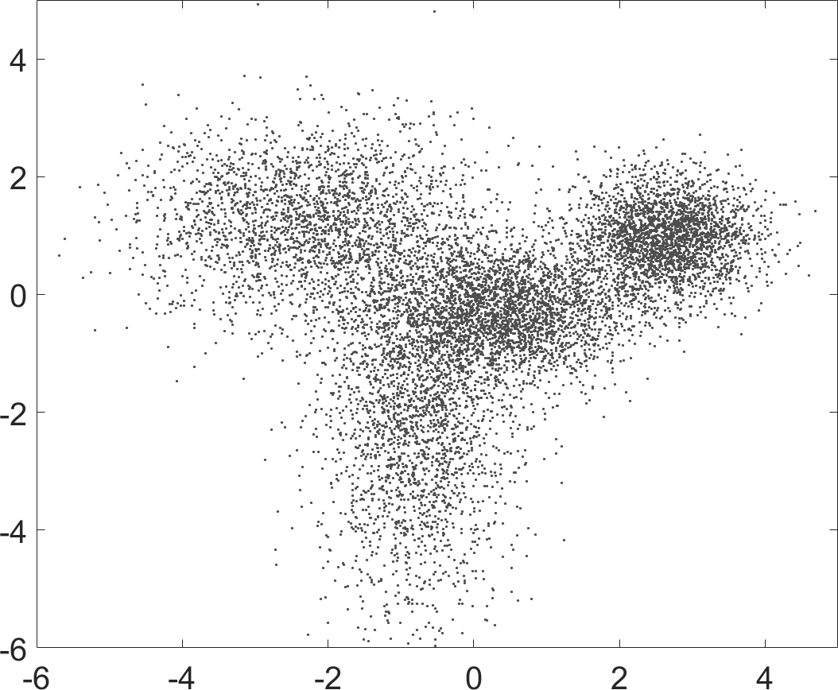
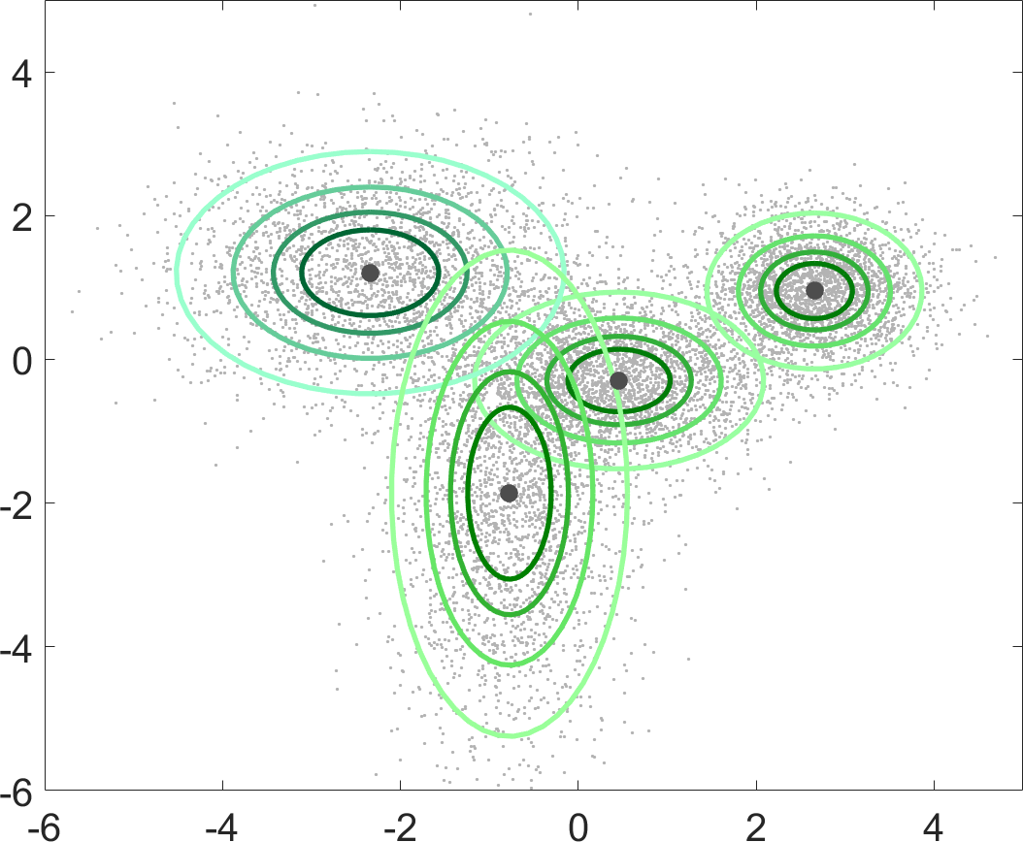
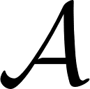
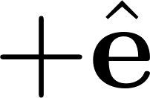
Recall: Linear inverse problem
Best algorithm possible
True distribution:
Sketch:
Estimation problem = linear inverse problem on measures
Extremely ill-posed !
Feasibility? (information-preservation)
10/24

Slide 14
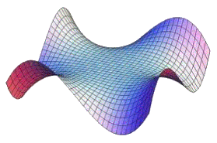
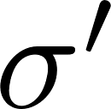
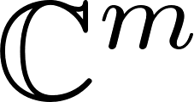
Information preservation guarantees
: Model set of « simple » distributions (eg. GMMs)
Non-convex generalized moment matching
Goal
Prove the existence of a decoder robust to noise and stable to modeling error.
Lower Restricted Isometry Property
« Instance-optimal » decoder
New goal: find/construct models and operators that satisfy the LRIP (w.h.p.)
11/24

Slide 15
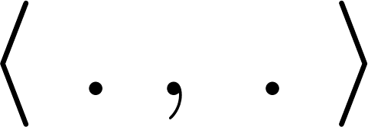
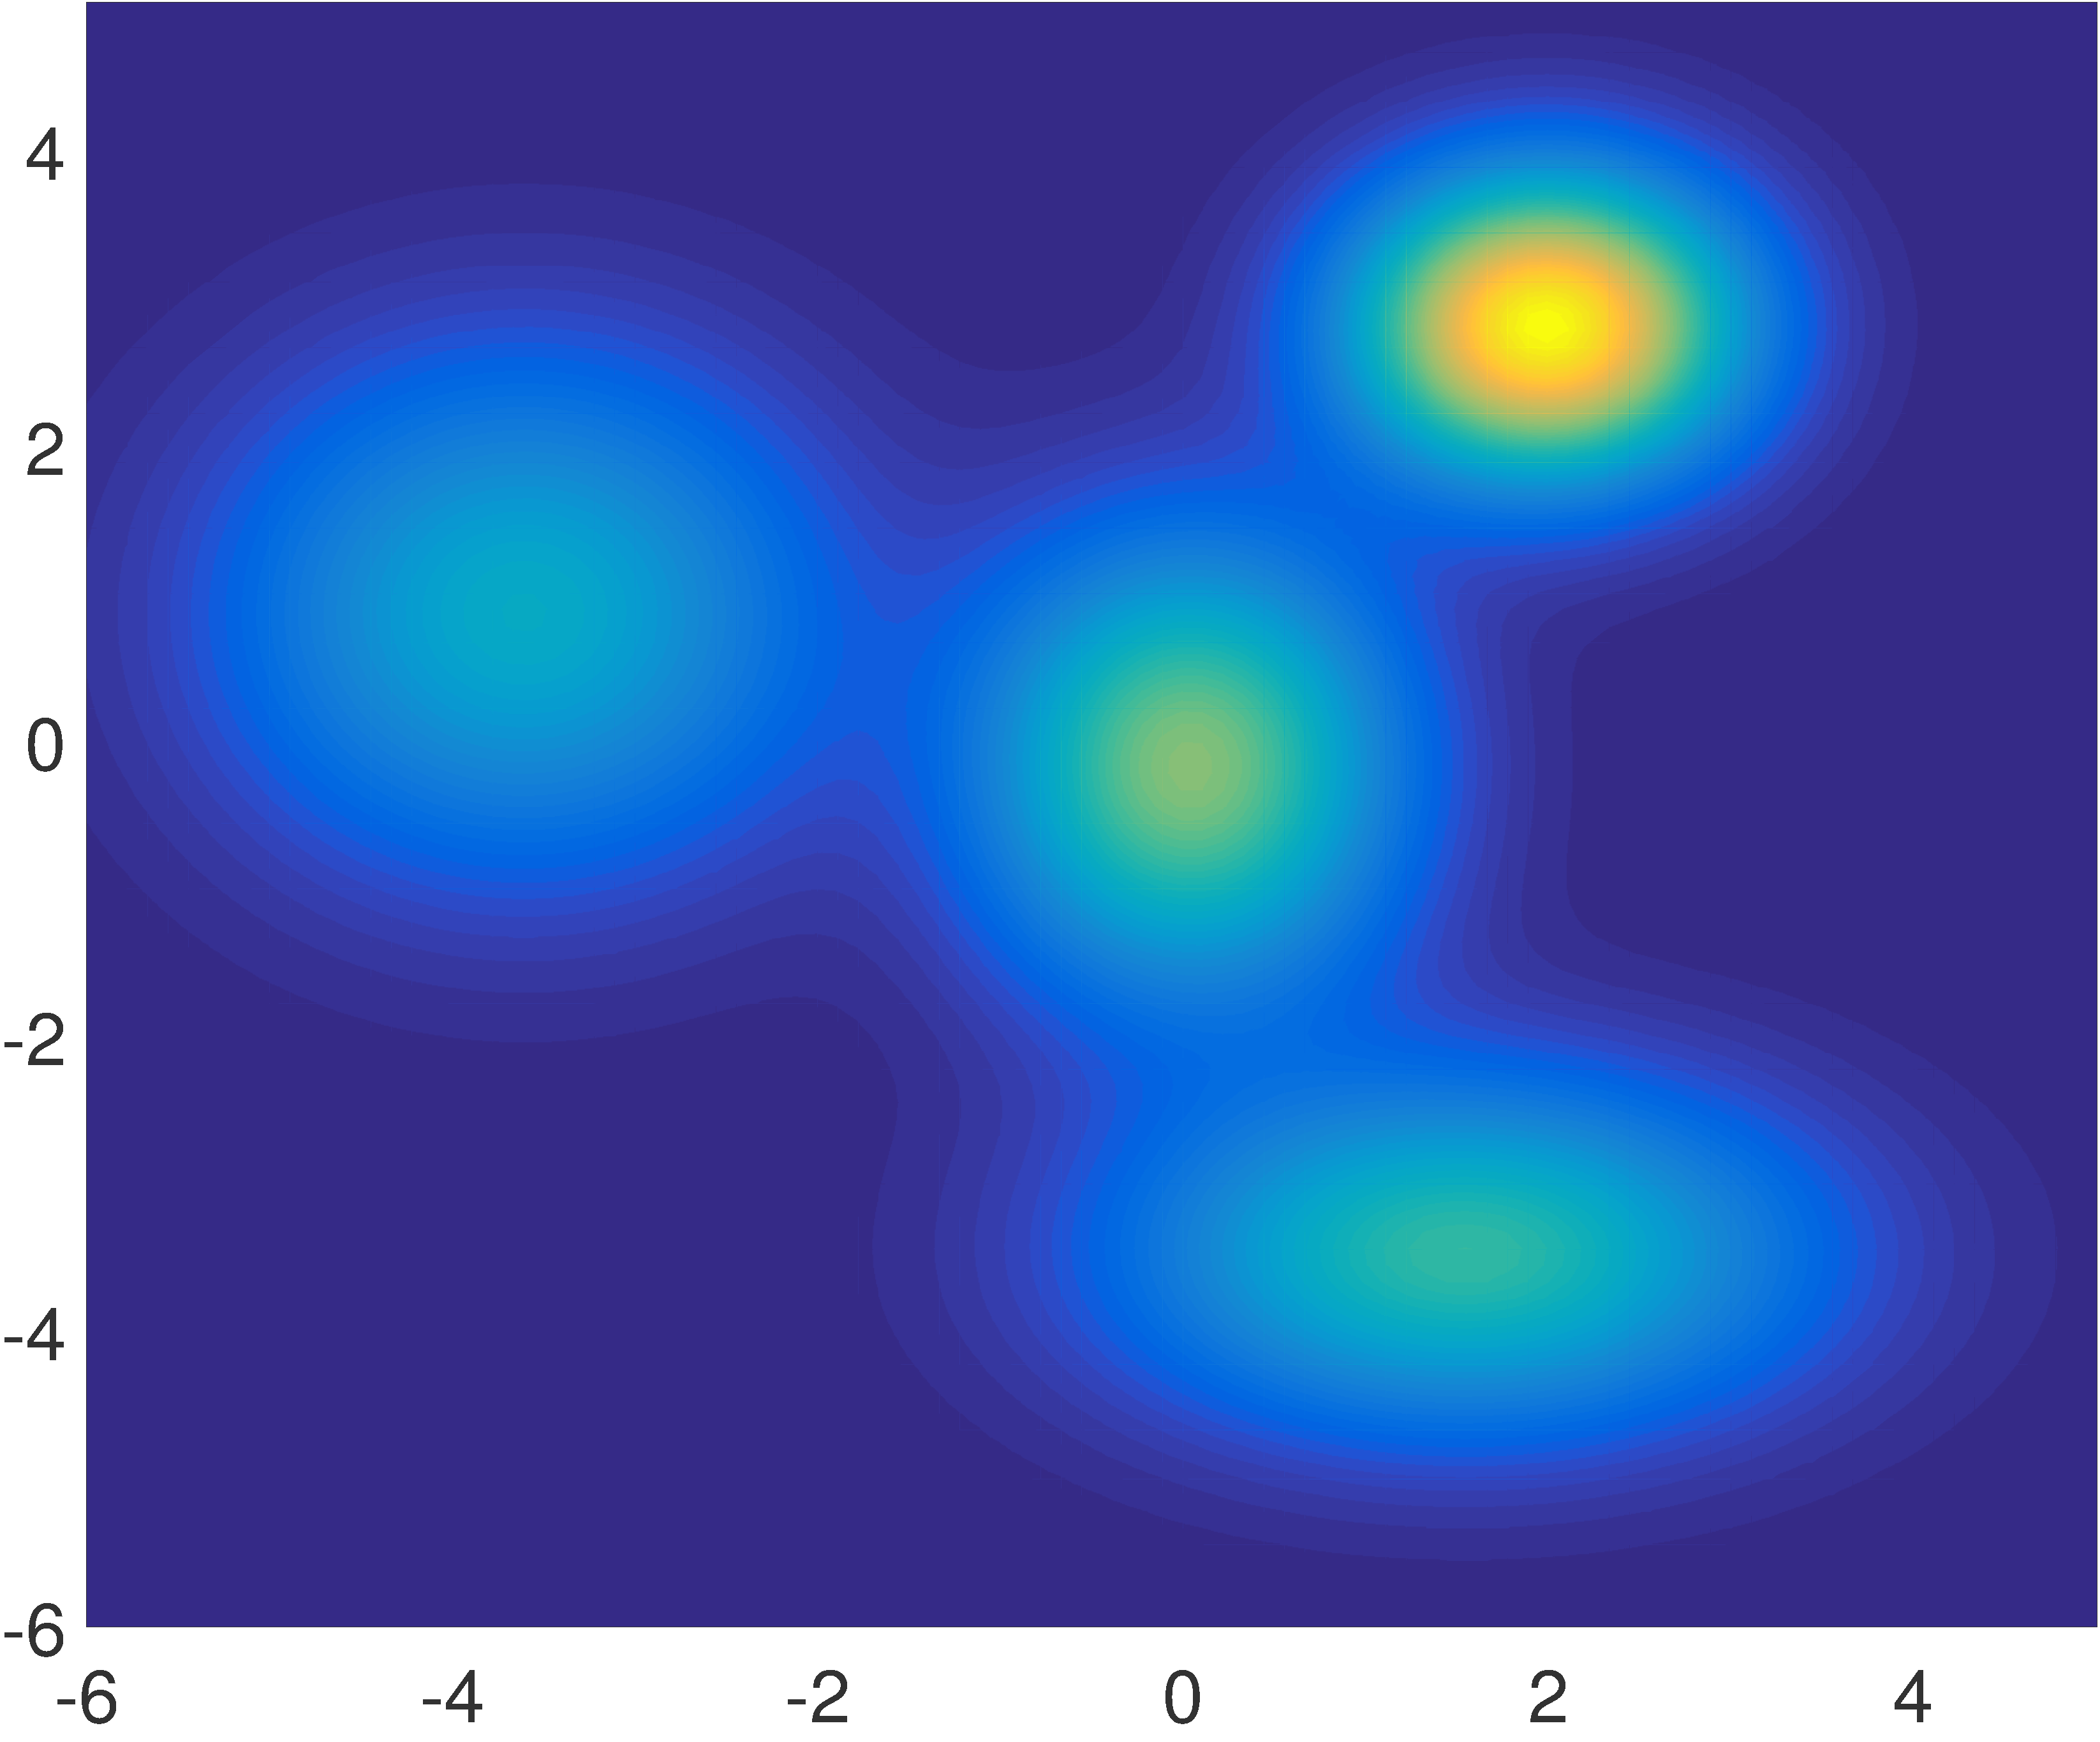
Appropriate metric
Goal: LRIP
Reproducing kernel:
: random features [Rahimi 2007] to approximate
Kernel mean [Gretton 2006]
Basis for LRIP
12/24

Slide 16
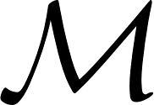
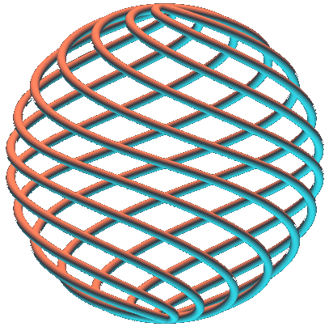
Proof strategy (1)
Reformulation of the LRIP
Goal: LRIP
Definition: Normalized Secant set
New goal
With high probability on :
for all , .
12/24

Slide 17
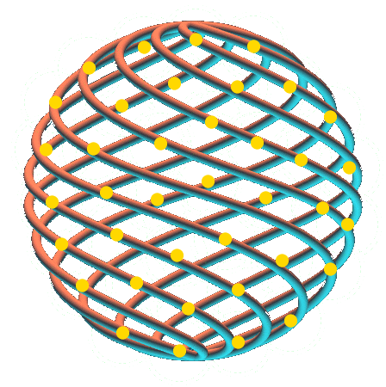
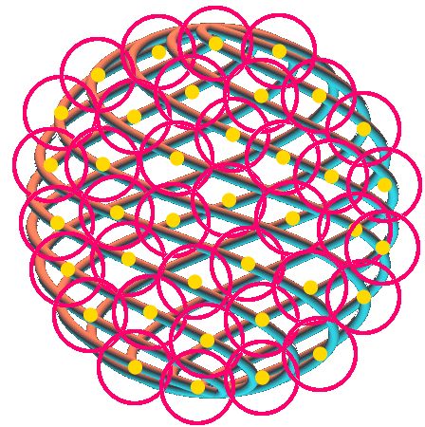
Proof strategy (2)
Goal: LRIP
Pointwise LRIP:
Concentration inequality
Extension to LRIP:
covering numbers
13/24

Slide 18
Main result
Main hypothesis
The normalized secant set has finite covering numbers.
Result
For ,
W.h.p.
Quality of pointwise LRIP
Dimensionality of the model
Modeling error
Empirical noise
Classic Compressive Sensing: finite dimension: Known
Here: infinite dimension: Technical
14/24

Slide 19
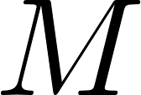
Application
k-means with mixtures of Diracs
GMM with known covariance
(no assumption on the data)
Hypotheses
- separated centroids
- bounded domain for centroids
Hypotheses
Sufficiently separated means
Bounded domain for means
Sketch
Adjusted Random Fourier features (for technical reasons)
Sketch
Fourier features
Result
W.r.t. k-means usual cost (SSE)
Result
With respect to log-likelihood
Sketch size
Sketch size
15/24

Slide 20
Summary
With the RIP analysis:
Moment matching: best decoder possible (instance optimal)
Information-preservation guarantees
Fine control on modeling error, noise, and metrics
Can incorporate k-means cost or log-likelihood
Compressive Sensing:
Random, dimensionality-reducing operator
Sparsity
The information is preserved
Convex relaxation?
16/24

Slide 21
Outline
Information-preservation guarantees: a RIP analysis
Total variation regularization:
a dual certificate analysis
Joint work with C. Poon, G. Peyré
Conclusion, outlooks

Slide 22
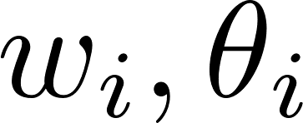
Total Variation regularization
Previously: RIP analysis
Must know
Non-convex !
Minimization: moment matching
Convex relaxation (« super resolution »)
Convex:
can be « handled » by eg Frank-Wolfe algorithm [Boyd 2015], or in some cases as a SDP
Questions:
Is the measure sparse ?
Does it have the right number of components ?
Does it recover the true ?
: Radon measure
: Total variation (« L1 norm »)
17/24

Slide 23
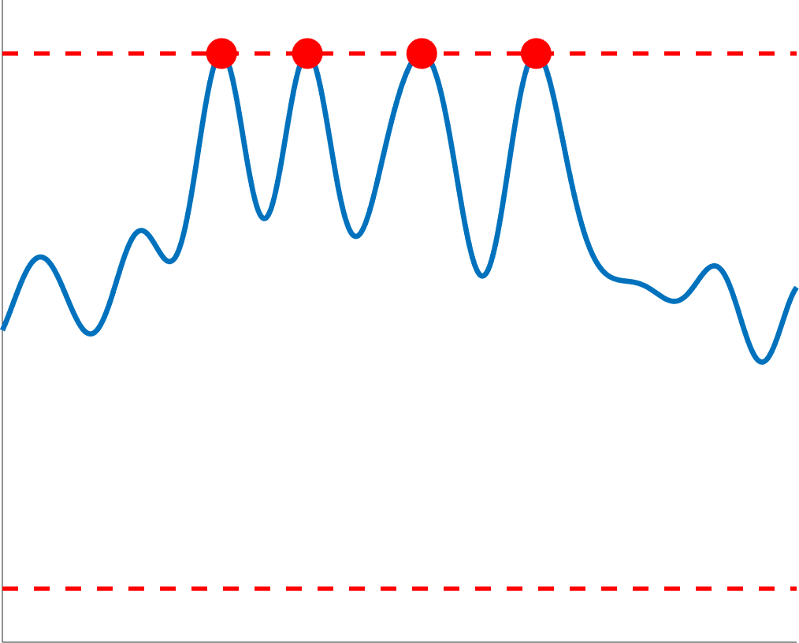
A bit of convex analysis
Intuition: first order conditions: solution
Def. : Dual certificate ( = Lagrange multiplier in the noiseless case…)
What is a dual certificate?
Such that, if :
otherwise
Ensures uniqueness and robustness…
18/24

Slide 24
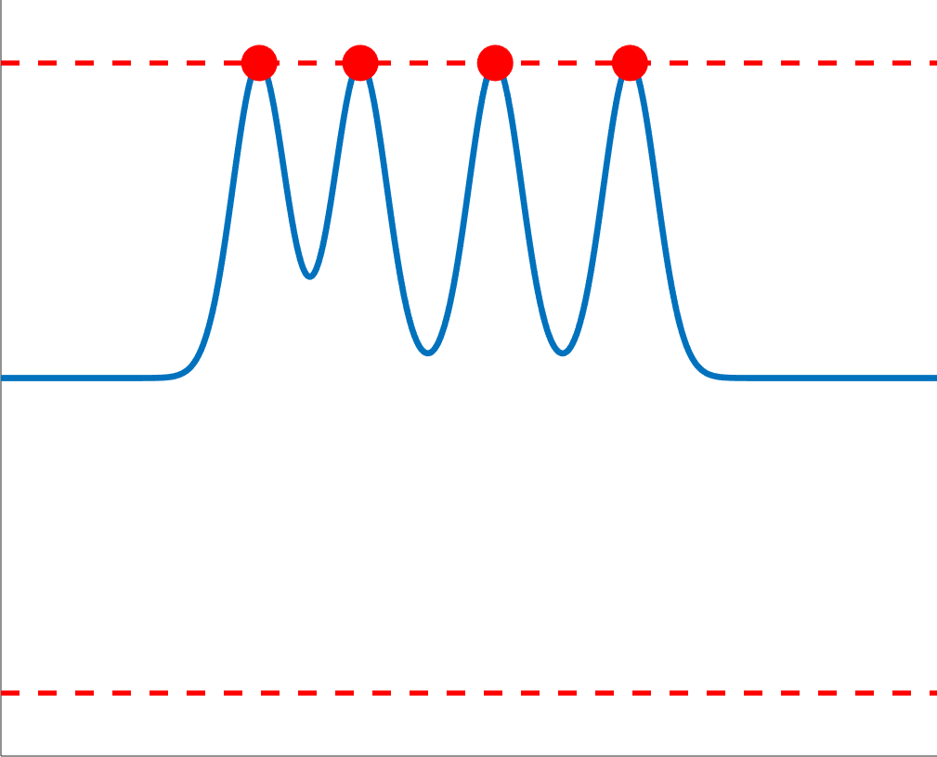
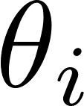
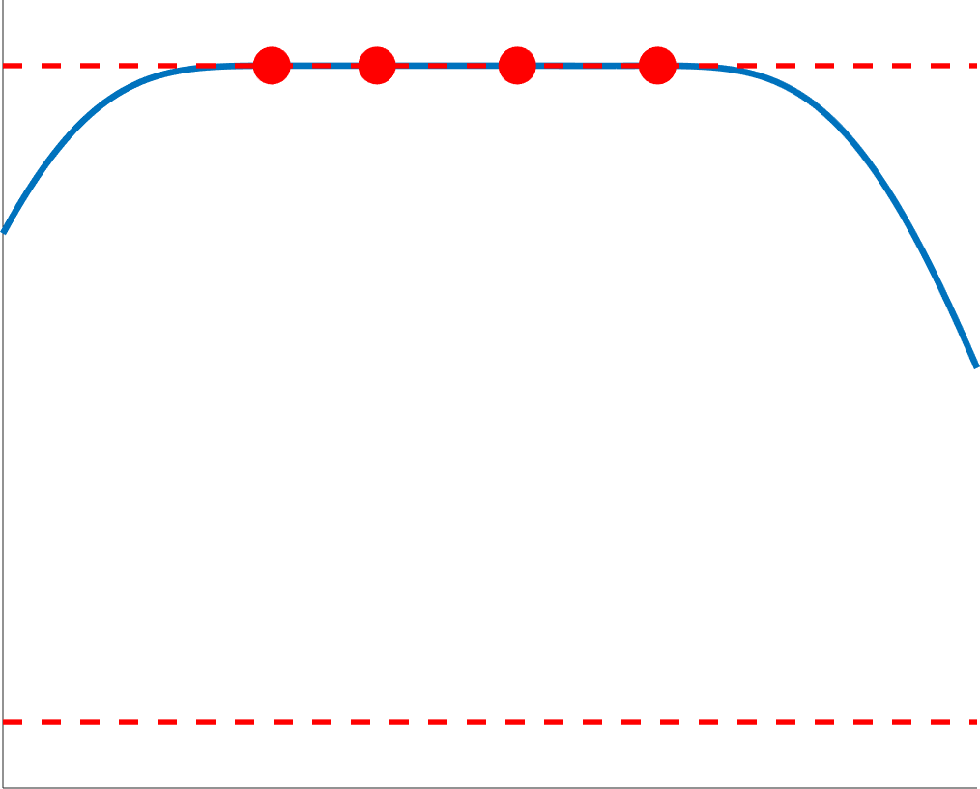
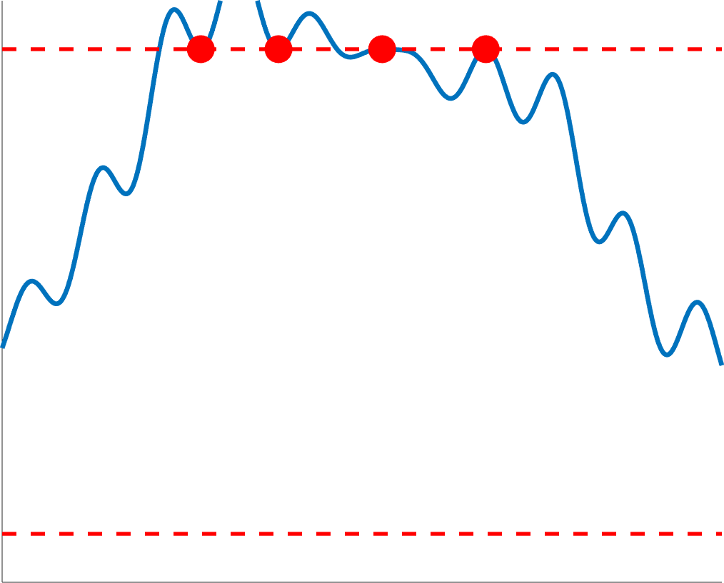
Strategy: going back to random features
Step 1: study full kernel
Assumptions:
Kernel « well-behaved »
sufficiently separated
Step 2: bounding the deviations
Pointwise deviation (concentration ineq.)
Covering numbers
m=10
m=20
m=50
19/24

Slide 25
Results for separated GMM
Assumption: data are actually drawn from a GMM…
1: Ideal scaling in sparsity
not necessarily sparse, but:
Mass of concentrated around true
Proof: infinite-dimensional golfing scheme (new)
In progress…
2: Minimal norm certificate
[Duval, Peyré 2015]
when n high enough: sparse, with right number of components
Proof: adaptation of [Tang, Recht 2013] (constructive)
In progress…
20/24

Slide 26
Outline
Information-preservation guarantees: a RIP analysis
Total variation regularization:
a dual certificate analysis
Conclusion, outlooks

Slide 27
Sketch learning
Sketching :
Streaming, distributed learning
Original view on data compression and generalized moments
Combines random features and kernel mean with infinite dimensional Compressive sensing
21/24

Slide 28
Summary, outlooks
RIP analysis
Information preservation guarantees
Fine control on noise, modeling error (instance optimal decoder) and recovery metrics
Necessary and sufficient conditions
But: Non-convex minimization
Dual certificate analysis
Convex minimization
Does not handle modelling error
In some cases, automatically guess the right number of components
Outlooks
Algorithms for TV minimization
Other features (not necessarily random…)
Other « sketched » learning tasks
Multilayer sketches ?
22/24

Slide 29
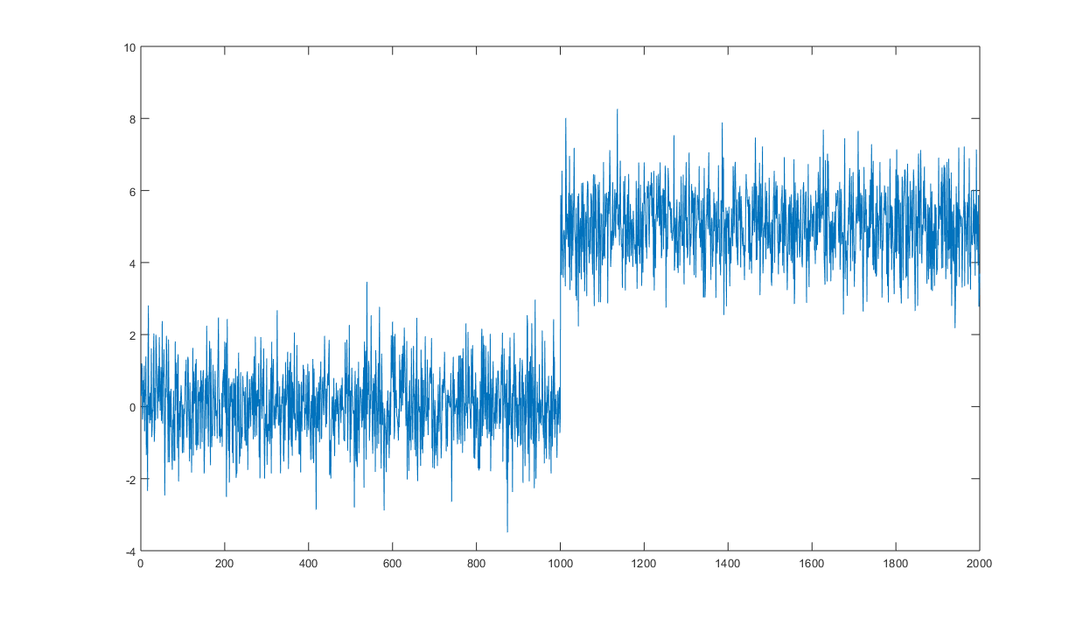
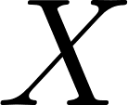
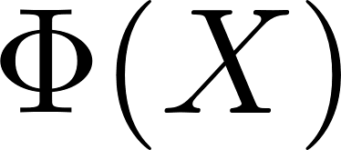
Online change point detection with sketches
Ongoing work with I. Poli, L. Daudet
Classical : detect variations in the mean of
With random features : detect variations in the mean of
= any change in distribution w.h.p.
Use of optical hardware dedicated to random features:
Sketch update in
Toy example: On a small laptop, no parallel computing, memory footprint < 5kb…
23/24

Slide 30
Thank you !
Keriven, Bourrier, Gribonval, Pérez. Sketching for Large-Scale Learning of Mixture Models Information & Inference: a Journal of the IMA, 2017. <arXiv:1606.02838>
Keriven, Tremblay, Traonmilin, Gribonval. Compressive k-means ICASSP, 2017.
Keriven, Deleforge, Liutkus. Blind Source Separation Using Mixtures of Alpha-Stable Distributions . ICASSP, 2018
Keriven. Sketching for Large-Scale Learning of Mixture Models. PhD Thesis. <tel-01620815>
Gribonval, Blanchard, Keriven, Traonmilin. Compressive Statistical Learning with Random Feature Moments. Preprint 2017. <arXiv:1706.07180>
Poon, Keriven, Peyré. A Dual Certificates Analysis of Compressive Off-the-Grid Recovery. Submitted
Code: sketchml.gforge.inria.fr,
github: nkeriven
data-ens.github.io
Come to the colloquium!
Come to the Laplace seminars!
24/24

